Slide 1
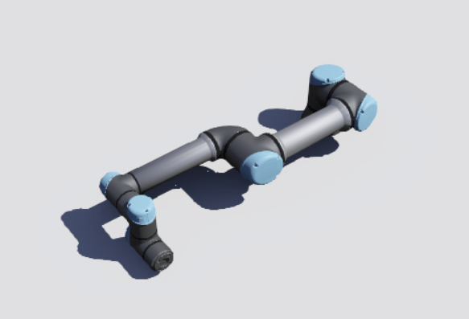
Industrial Robotic Arm
Dr.Elshimaa Nabil Nada

Slide 2
Team
محمد محمود محمد غانم
أحمد جمال عزقلاني عطية
أحمد محمد سالم محمد
حسام صلاح إبراهيم محمود
عبد الرحمن علاء أحمد مصلحي السَّيد
كريم وائل طلبة محمد
محمد طارق عبد الحافظ عبد الواحد
محمد عبد الحميد فخري عبد الحميد
محمد مصطفى محمد أحمد عبد الله
مصطفى حسن جاب الله عطية محمود
يوسف أسامة السَّيد محمد أحمد

Slide 3
Abstract
1. What (Project Description)
This project implements an automated fruit-sorting system using a robotic arm with a gripper, camera, and distance sensor. A conveyor belt delivers apples and oranges, and the camera identifies each fruit using image recognition. The distance sensor ensures the fruit is exactly under the gripper before picking it up, providing accurate timing and reliable grasping. After detection and confirmation, the robot collects the fruit and places it into the correct box. The system operates autonomously to achieve fast and accurate sorting.
2. Why (Purpose of the Project)
The goal of this project is to automate fruit‑sorting processes in industrial environments. Manual sorting is time‑consuming, error‑prone, and inefficient for large‑scale production. Automation improves accuracy, speed, and consistency while reducing human workload.

Slide 4
Abstract
3. How (System Design & Methodology)
The system was developed using the Webots simulation platform and consists of several integrated components:
  A robotic arm driven by multiple motors to achieve multi-axis movement.
  A gripper mechanism designed to securely pick fruits from the conveyor belt.
  An embedded Webots recognition camera used for detecting and identifying apples and oranges.

Slide 5
Abstract
Camera Activation: The camera and its recognition features are enabled using the Webots C API:
Reading Recognized Objects: The system obtains information about detected fruits through:

Slide 6
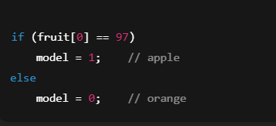
Abstract
Each recognized object contains data such as model name, position, and size. Fruit classification is performed by examining the model string returned by Webots. If the first character corresponds to ASCII value 97 ('a'), the fruit is classified as an apple; otherwise, it is identified as an orange.
Sorting Mechanism: Once the fruit type is determined, the microcontroller processes the recognition data and commands the robotic arm. The arm moves to the correct position, grips the fruit, and places it into the designated box, ensuring accurate and automated sorting

Slide 7
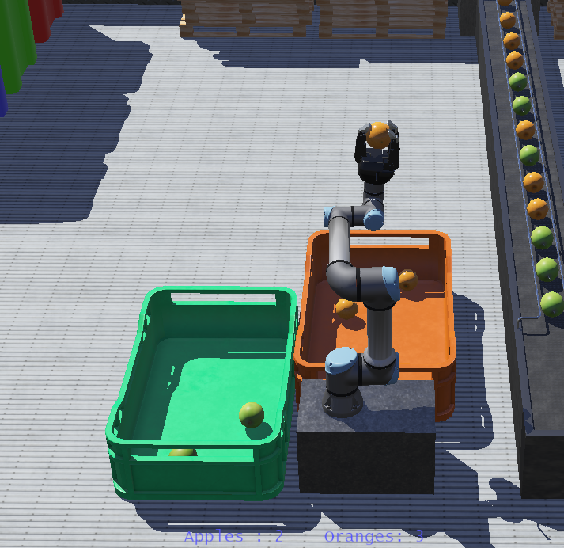
Abstract
4. Results
The robotic arm successfully detected, picked, and sorted apples and oranges based on real‑time camera input. The system operated smoothly during conveyor movement, and the arm accurately placed each fruit in its designated box.

Slide 8
Abstract
5. Conclusion
The fruit‑sorting system demonstrates an effective use of robotics and embedded systems for industrial automation. The project shows how integrating mechanical actuation, computer vision, and real‑time control can significantly improve production line efficiency. This approach can be expanded for sorting different items and scaled for industrial applications

Slide 9
Literature Review
Topic / Area | Key Findings from Literature | Technologies Used in Research | Relevance to Your Project
Automated Fruit Sorting Systems | Automation improves speed, accuracy, and consistency compared to manual sorting. Early systems relied on simple mechanical grading. | Conveyor belts, mechanical graders, RGB cameras | Your system uses a conveyor + camera setup and replaces manual sorting with robotic automation.
Machine Vision in Sorting | Color, shape, and texture are the most common features used to classify fruits. Recent systems use deep learning for high accuracy. | RGB/HSV color segmentation, CNNs, YOLO, OpenCV | You classify fruits by color detection, similar to early machine vision research.
Robotic Arms in Agriculture & Industry | UR5/UR5e are widely used due to precision, flexibility, and ease of integration. Manipulators improve throughput and reduce human labor. | UR5, 6-DOF arms, IK solvers, ROS, Webots | Your project uses a UR5-like robotic arm in Webots for pick-and-place sorting.
Real-Time Pick-and-Place Control | Accurate grasping requires correct timing, IK control, and object pose estimation. Moving conveyors add complexity. | Inverse kinematics, Trajectory planning, Vision-based pose estimation | Your controller uses IK and object tracking to pick fruits from a moving belt.
Conveyor Belt Automation | Conveyors ensure continuous, uniform fruit flow. Synchronizing robot timing with conveyor motion is crucial. | Adjustable-speed conveyors, encoders, sensors | You simulate a conveyor at 0.15 m/s for continuous fruit feeding.
Fruit Classification Research | Classification research spans apples, oranges, mangoes, tomatoes, etc. Methods include color-based and deep-learning models. | CNNs, SVM, Color histograms, Multispectral imaging | Demonstrates how your simple two-class system (Apple/Orange) fits into broader classification studies.
Sorting Accuracy & Performance | Studies show automation improves throughput and reduces errors from human fatigue. | High-resolution cameras, PLC/SCADA systems | Your project targets similar performance goals through simulation.
Simulation-Based Robotics Research | Webots, Gazebo, and ROS simulations help prototype industrial applications at low cost before real-world deployment. | Webots, ROS, Unity, MATLAB | Your entire system is a simulation-based prototype, aligning with modern development practices.

Slide 10
Literature Review
Aspect | Advantages | Disadvantages / Limitations
Automation & Efficiency | • High sorting speed compared to manual labor. • Works continuously without fatigue. • Reduces human errors and increases productivity. | • Requires initial setup cost. • Performance depends on accurate calibration and control tuning.
Accuracy of Classification | • Consistent color-based detection eliminates subjective human judgment. • Robot executes identical sorting patterns every time. | • Simple color detection may fail under varying lighting conditions. • Cannot detect defects unless advanced vision (CNN) is added.
Robotic Arm (UR-type) | • High precision in pick-and-place operations. • Flexible 6-DOF motion suitable for complex environments. • Safe and collaborative in real industrial settings. | • Inverse kinematics complexity increases computational load. • Limited payload — suitable only for lightweight objects like fruits.
Conveyor Belt Integration | • Ensures continuous fruit flow. • Ideal for real-time sorting with synchronized robot timing. | • Moving conveyor requires fast perception and reaction times. • Object slippage or rotation may affect grasp accuracy.
Scalability | • System can be extended to multiple fruit types. • Easy to modify in simulation (Webots). • Adaptable to industry 4.0 environments. | • Adding more fruit classes requires more complex classification methods. • Increasing system speed may require better hardware and optimized algorithms.
Simulation Environment (Webots) | • Low-cost prototyping environment. • Safe space for testing without damaging hardware. • Easy visualization of robot behavior and conveyor motion. | • Simulation does not fully replicate real-world physics. • Requires additional effort to port the solution to real hardware (e.g., UR5 + camera).
Maintenance & Reliability | • Reduced human involvement lowers contamination and safety risks. • Automated systems require less day-to-day supervision. | • Requires periodic maintenance of robotic joints and conveyor parts. • Potential downtime in case of hardware failures.

Slide 11
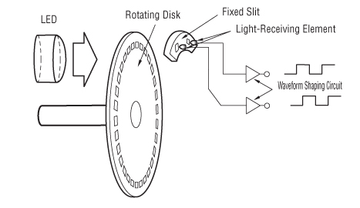
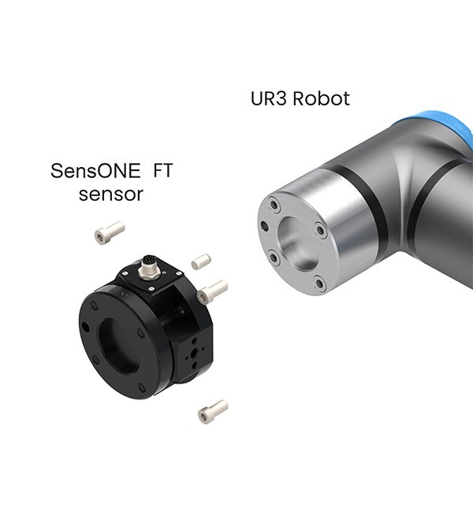
Analysis
First: Sensors
.1Force/Torque Sensor
Located in the end-wrist joint of the robot. It measures
three force components:
Fx, Fy, Fz
three torque components:
Tx, Ty, Tz
This sensor enables the robot to:
  Perform force-controlled operations
  Execute precise tasks that require physical contact
  Learn through touch (FreeDrive mode)
  Carry out sensitive insertion tasks such as press-fit assembly
2. Joint Position Sensors – Encoders
Each joint contains both absolute and incremental encoders.
Their functions include:
  Improving motion control
  Determining the joint angle with high accuracy
  Restoring joint position after rebooting
  Preventing trajectory errors or path deviation

Slide 12
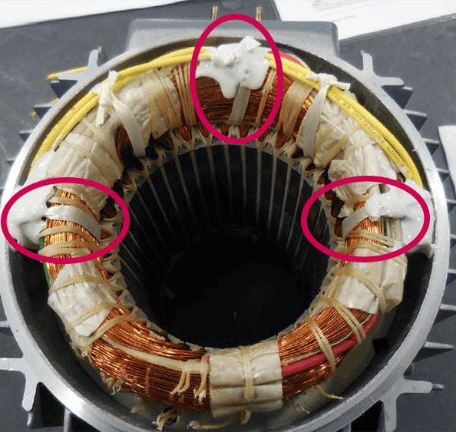
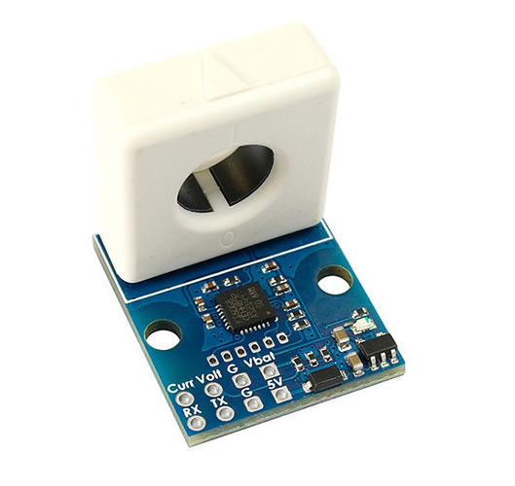
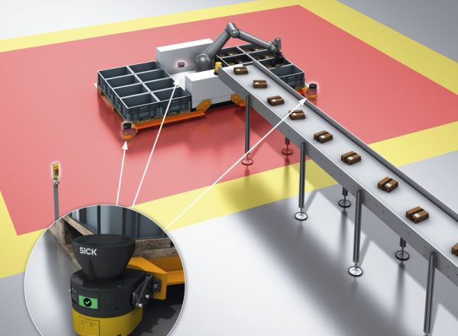
Analysis
3. Temperature Sensors
Located inside every motor to prevent overheating.
They are used for:
  Overload protection
  Reducing motor power if temperature exceeds safety limits
  Preventing sudden system shutdowns
4. Motor Current Sensors
These measure the electrical current flowing inside each servo motor
They enable the robot to:
  Estimate the actual torque in real time
  Detect early collisions
  Activate safety features such as Safe Stop
5. Safety Sensor System
The UR5e includes an integrated safety system consisting of:
  Monitoring joint speed and acceleration
  Supervising motion and speed limits
  Embedded collision-detection mechanisms
  Supporting Safe Zones and Reduced Mode for human-robot collaboration

Slide 13
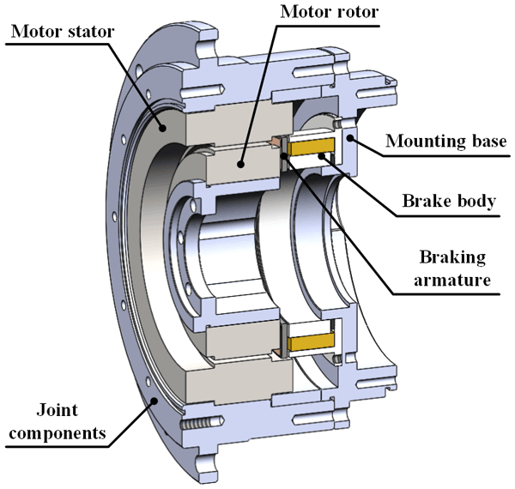
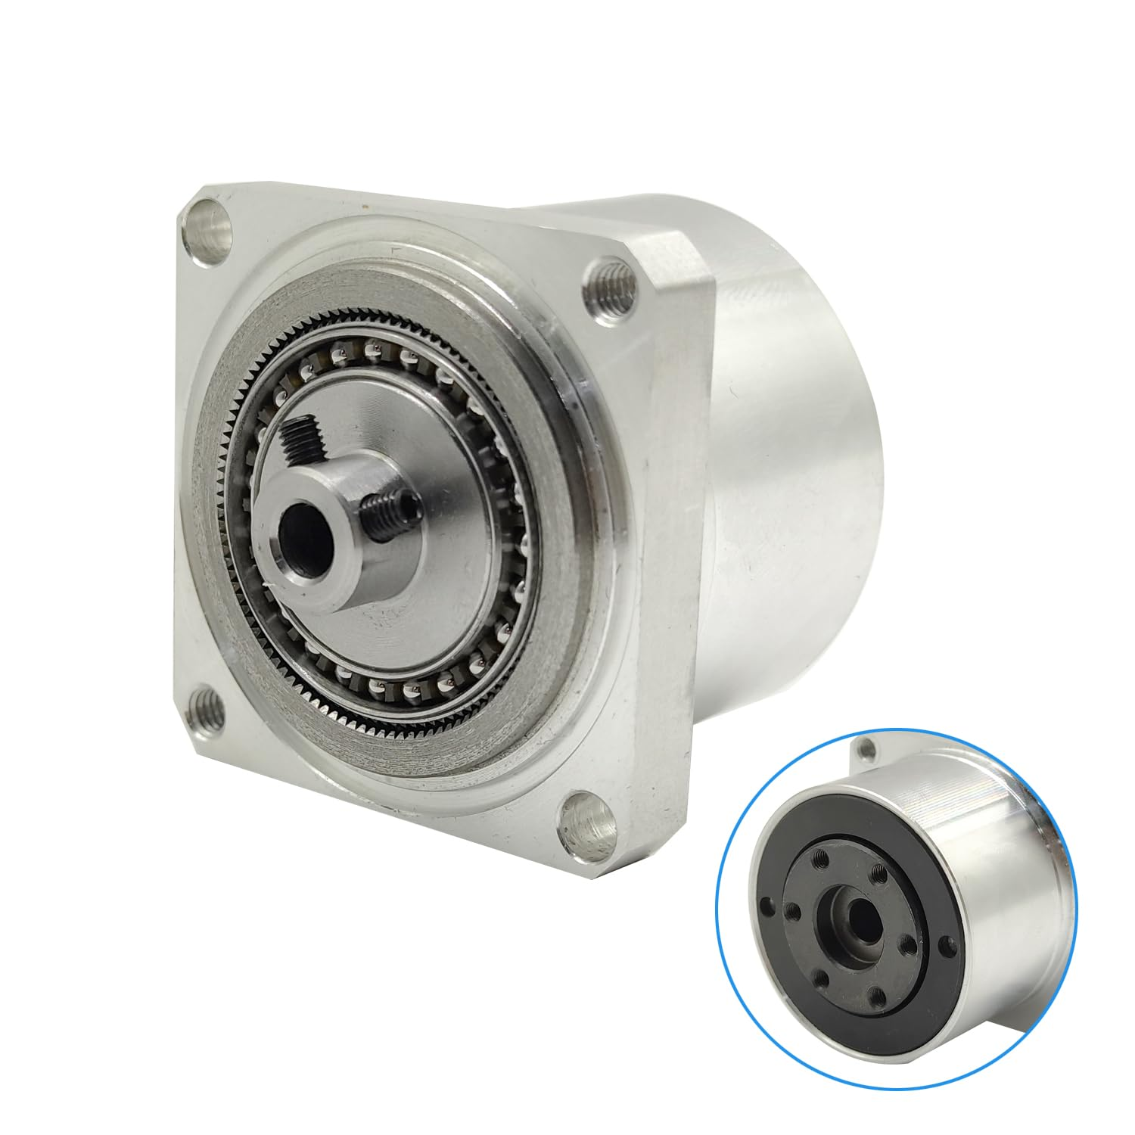
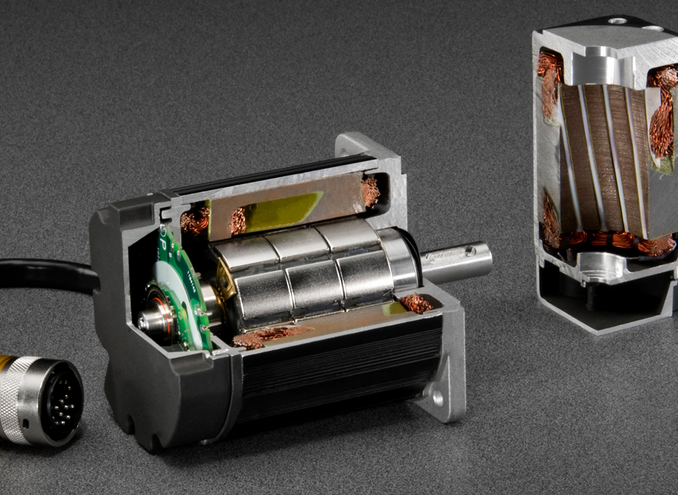
Analysis
Second: Actuators
1. AC Brushless Servo Motors
These are the primary motors responsible for driving the joints.
Their characteristics include:
  Operate using AC power
  High efficiency
  Excellent dynamic response
  Smooth movement with minimal vibration
  Ability to monitor torque and speed in real time
2. Harmonic Drive Gearboxes
Among the most accurate motion-transmission systems in robotics.
Their advantages:
  Nearly zero backlash
  High reduction ratio
  Compact size and lightweight
  Significantly increase motor output torque
3. Mechanical Holding Brakes
Installed in selected joints to maintain the robot’s position during:
  Power loss
  Robot shutdown

Slide 14
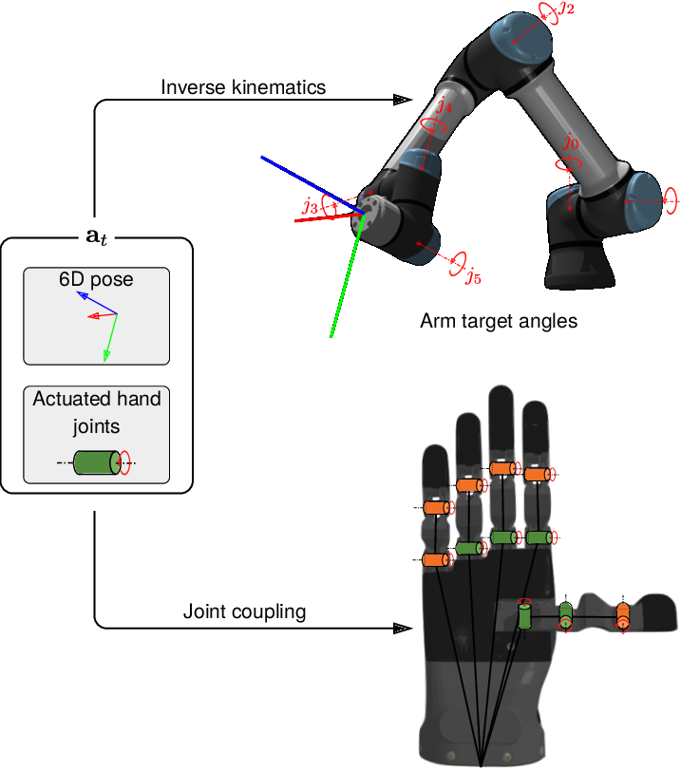
Analysis
In Gripper:
Sensors
1.Distance Sensor (Infrared or Optical Range Sensor):
  Mounted near the front of the gripper.
  Measures the distance to the incoming fruit.
  Used to detect when a fruit is close enough to begin gripping.
2.Wrist Position Sensor (Not inside the gripper, but used with it)
  Measures the angle of the wrist joint.
  Used to detect when the arm has rotated to the dropping location.

Slide 15
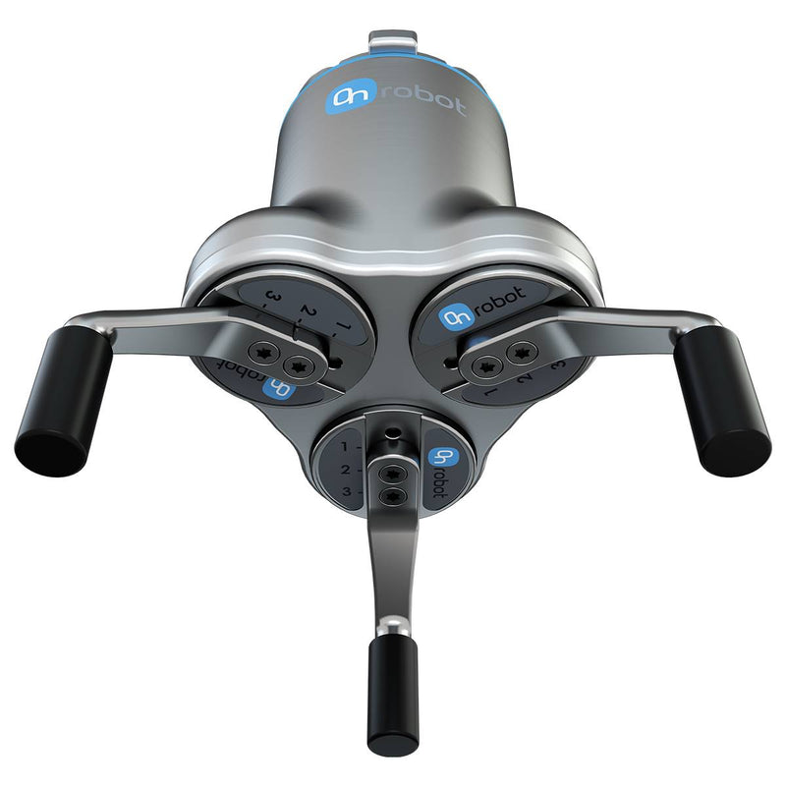
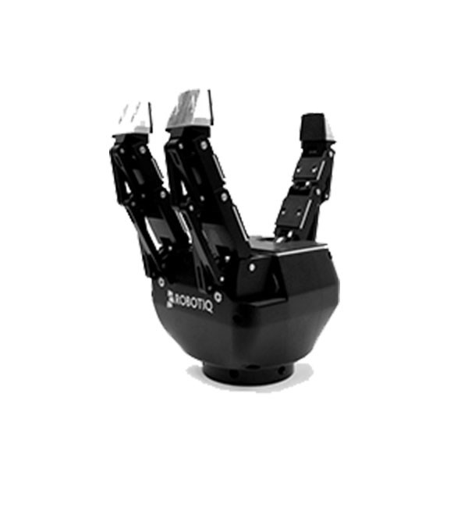
Analysis
Actuators
Motor 1 — finger_1_joint_1
  Controls the first finger (usually the right finger).
  Rotates to open or close the finger.
  Increasing the angle → more closing
Motor 2 — finger_2_joint_1
  Controls the second finger (left finger).
  Same mechanics as finger_1.
  Moves symmetrically to create a stable grip.
Motor 3 — finger_middle_joint_1
  Controls the middle finger at the bottom.
  Works together with the other two fingers to produce a 3-point gripping pattern, which is more stable than 2 fingers.

Slide 16
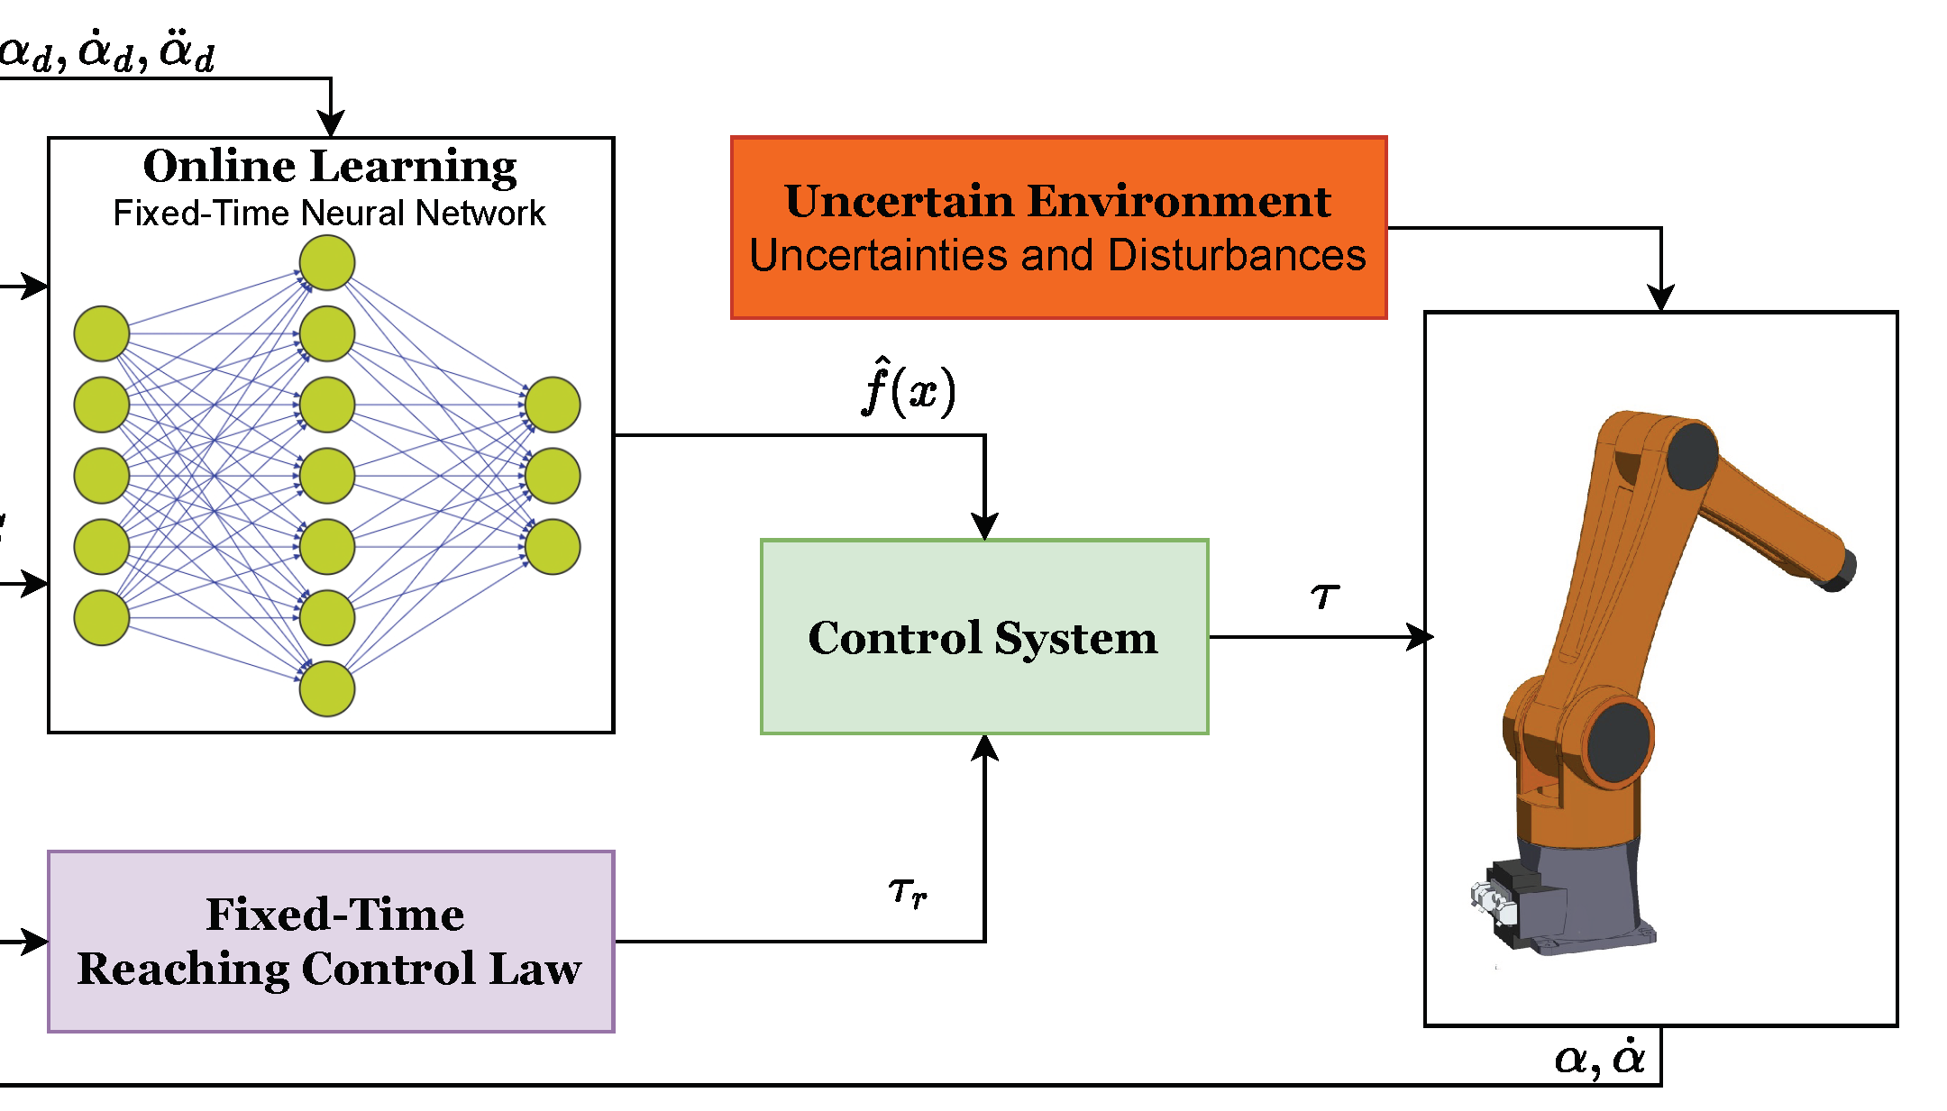
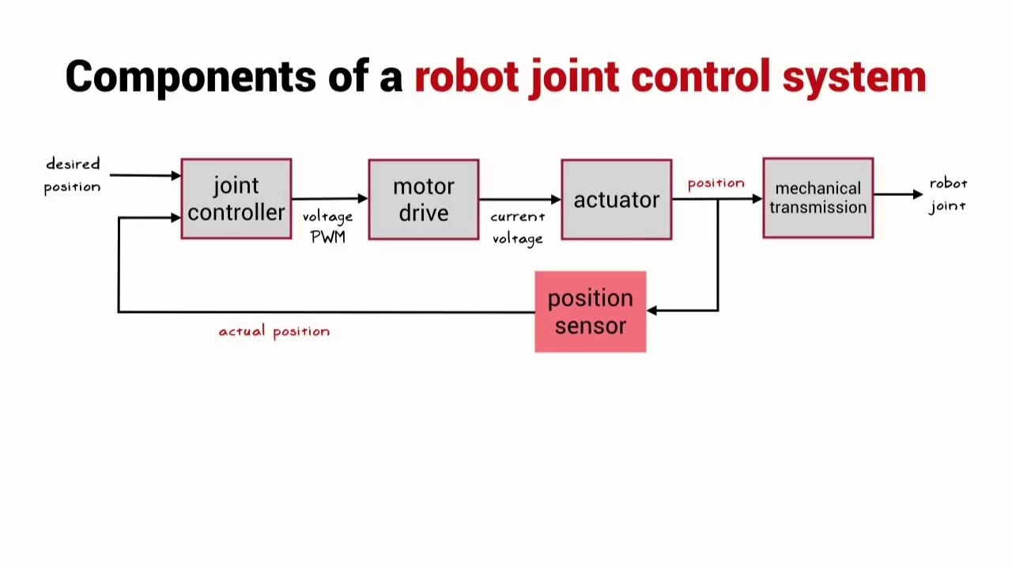
Analysis
Third: Controller Architecture
Two principal control strategies :
Independent Joint Control (PID) and Computed Torque Control (CTC).
Strategy A: Independent Joint Control (PID)
This conventional approach treats each joint as an independent control loop, neglecting inter-joint coupling under the assumption of sufficiently high gearing ratios.

Slide 17
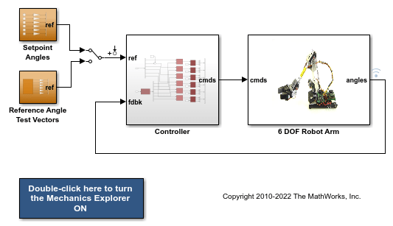
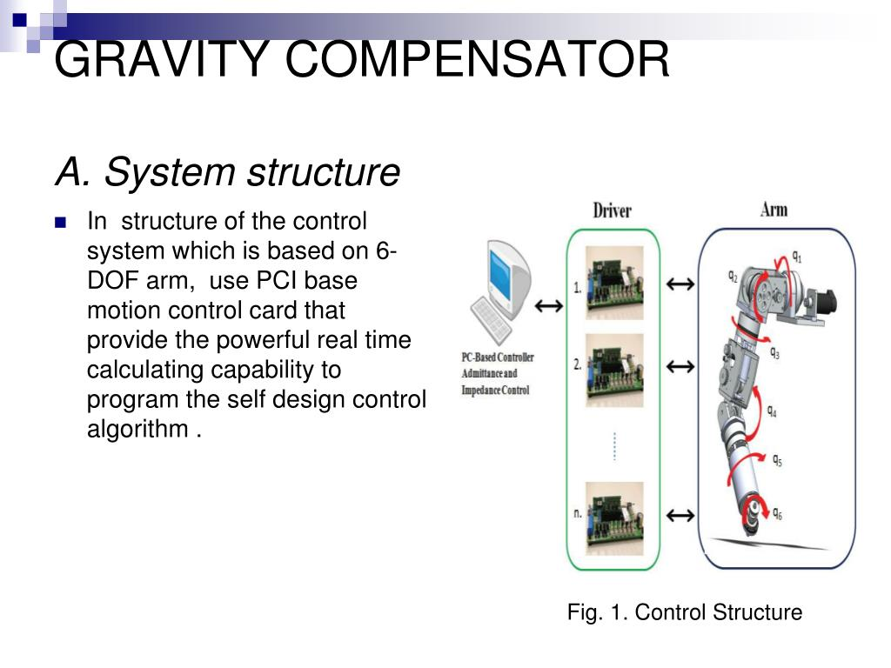
Analysis
The control law for the i-th joint is:
• Kp: Proportional gain, acting like a spring to reduce positional error.
• Kd: Derivative gain, acting like a damper to reduce oscillations.
• Ki: Integral gain, correcting steady-state errors.
• Gi(θ): Gravity compensation torque for joint i.
The gravity compensation term is indispensable since the PID controller alone cannot maintain static equilibrium against the robot’s weight

Slide 18
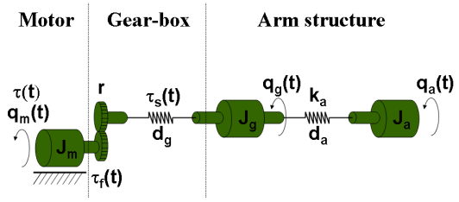


Analysis
Strategy B: Computed Torque Control (CTC)
This model-based control method utilizes the dynamic model to compensate for nonlinearities in real-time, resulting in improved accuracy particularly in high-speed or precision tasks.
The control law is:
where the error vectors are:

Slide 19

Analysis
By substituting the control input into the dynamics, the system behaves as a linear double integrator with error dynamics
This approach greatly enhances control performance but requires precise dynamic parameter identification and computational resources

Slide 20
Analysis
Feature | Independent Joint Control (PID) | Computed Torque Control (CTC)
Control Philosophy | Treats each joint as an independent system | Uses full robot dynamic model to linearize system
Model Requirement | ❌ No model needed | ✔ Requires inertia, Coriolis, gravity terms
Dynamic Coupling Handling | ❌ Ignores coupling | ✔ Compensates coupling between joints
Gravity Compensation | Not inherent | Built-in gravity compensation
Tracking Performance | Moderate | High precision & fast response
Computational Complexity | Low | High (matrix calculations)
Ease of Implementation | Very simple | Complex, requires modeling & computation
Tuning Difficulty | Easy (joint-by-joint PID gains) | Medium–Hard (PD/PID + dynamic model)
Robustness to Modeling Errors | High (no model dependency) | Medium (depends on model accuracy)
Sensitivity to Payload Changes | High (performance degrades) | Low (model compensates load variation)
Use in Industry | Low-cost or slow robots | High-end precise manipulators
Suitable For | Simple or slow movements | High-speed accurate trajectory tracking

Slide 21
Implement & Design
The design utilizes a Finite State Machine (FSM) in the main controller (fruit_sorting_controller.c) to manage the robot's sorting behavior.
1. Fruit Generation Controller (fruit_ctrl.c)
This is the Supervisor controller responsible for generating the fruit models on the conveyor belt.
Logic: After a warm-up time of 7.5 seconds, the controller randomly selects either an "apple" or an "orange" (up to 50 of each type).
Mechanism: It uses the Webots Supervisor API to retrieve the fruit node from the world tree and reset its position back onto the conveyor belt's starting point
2. Fruit Sorting Controller (fruit_sorting_controller.c)
This controller manages the UR5e robot and its sensors to execute the sorting task.

Slide 22
Implement & Design
State | Action | Transition Trigger
WAITING | Robot is idle, gripper open. | Distance Sensor detects fruit (< 500).
PICKING | Gripper closes (0.52 rad) to grasp the fruit. | Internal counter expires (counter = 0).
ROTATING | UR5e Arm moves to the target sorting bin position. | Position Sensor on wrist_1_joint reaches rotation target (< -2.3).
DROPPING | Gripper opens (min_position) to release the fruit. | Internal counter expires (counter = 0).
ROTATE_BACK | UR5e Arm returns to the initial waiting position. | Position Sensor on wrist_1_joint returns to origin proximity (> -0.1).
State Machine (FSM)

Slide 23
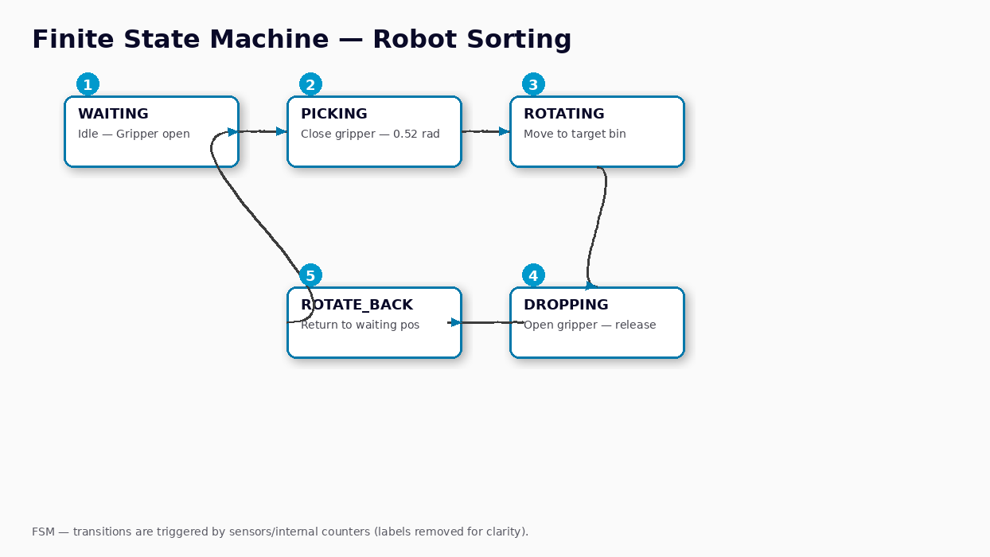
Implement & Design

Slide 24
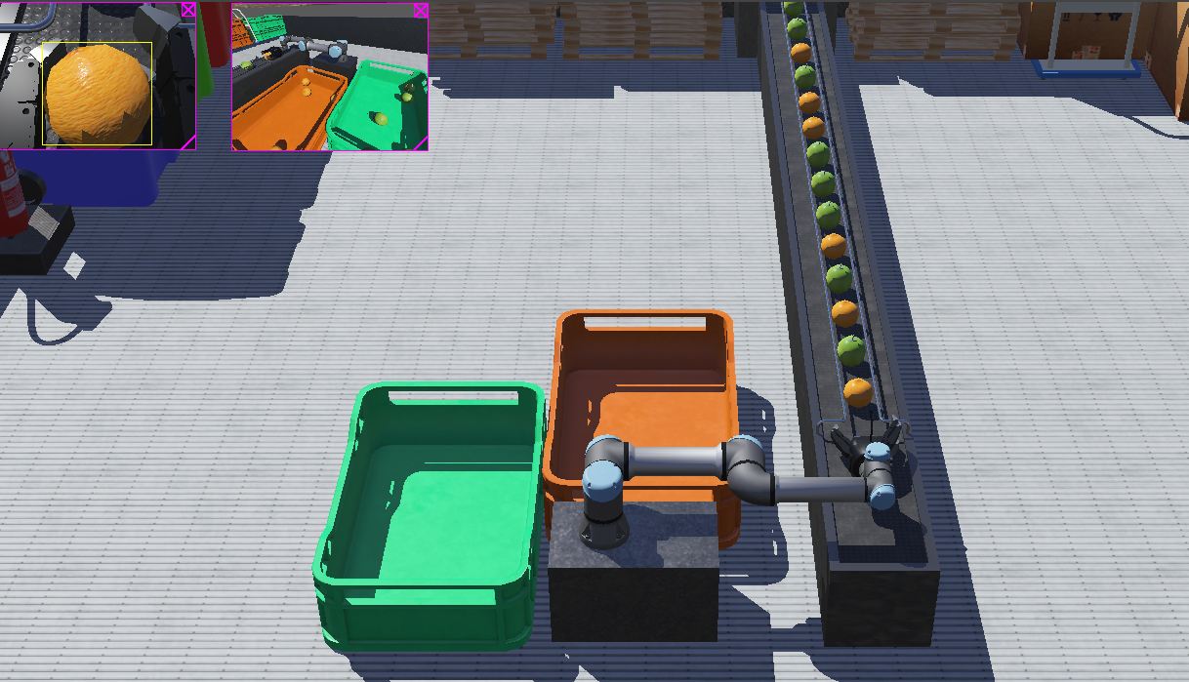
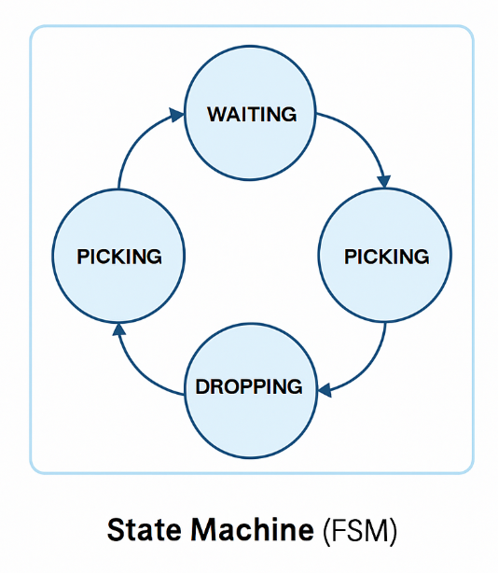
Implement & Design
Sensor-Based Sorting Logic
Distance Sensor: Detects the presence of an object at the pickup point, triggering the state transition from WAITING to PICKING.
Camera Recognition: The camera is enabled for recognition. It determines the fruit type by reading the first character of the object's model name (objects[0].model):
  If the first character is 'a' (ASCII 97), the fruit is an Apple (model = 1).
  Otherwise, it is an Orange (model = 0).
Arm Movement: The variable model dictates the target arm movement:
  Orange (model = 0): The robot sets the position for all 5 joints (i = 0 to 4), leading to the Orange Bin.
  Apple (model = 1): The robot sets the position for joints 1 through 4 (i = 1 to 4), which results in a different trajectory leading to the Apple Bin.

Slide 25
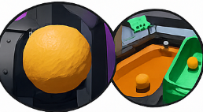
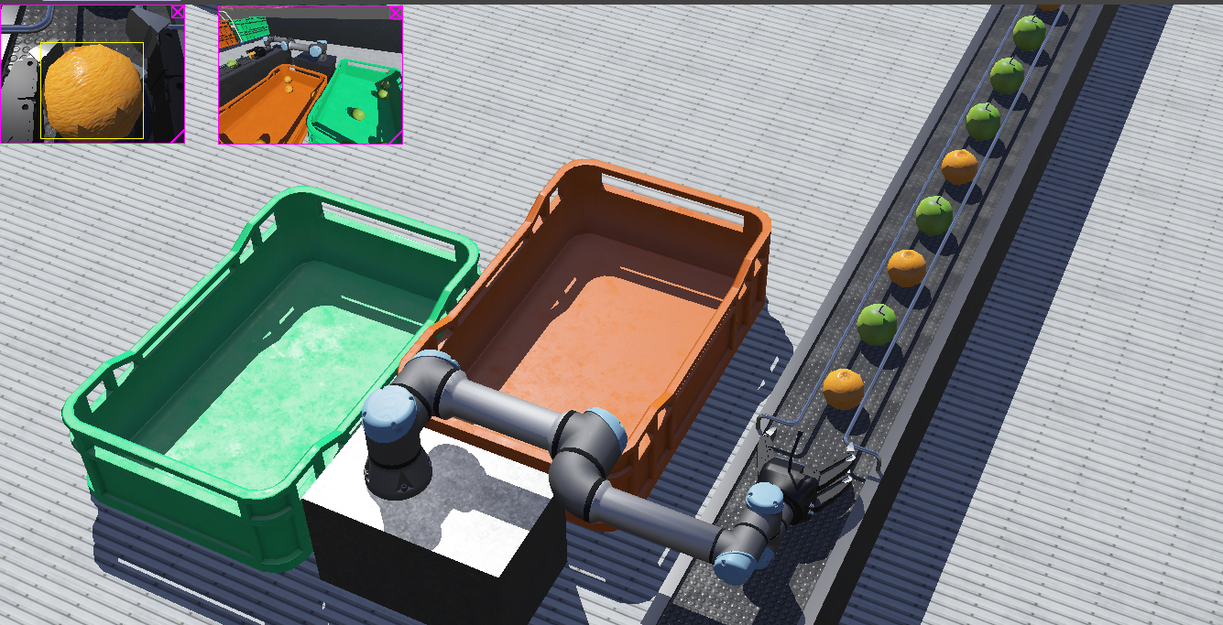
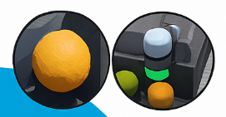
Test and Results
Test Procedure
The simulation is initiated, and fruits begin appearing on the conveyor belt.
The robot waits for the distance sensor to trigger.
Upon detection, the camera identifies the fruit type.
The arm picks up the fruit and moves to the pre-defined target position (target_positions) corresponding to the fruit type.
The fruit is dropped into the correct bin (Green for Apples, Orange for Oranges).
The robot returns to the WAITING position.

Slide 26
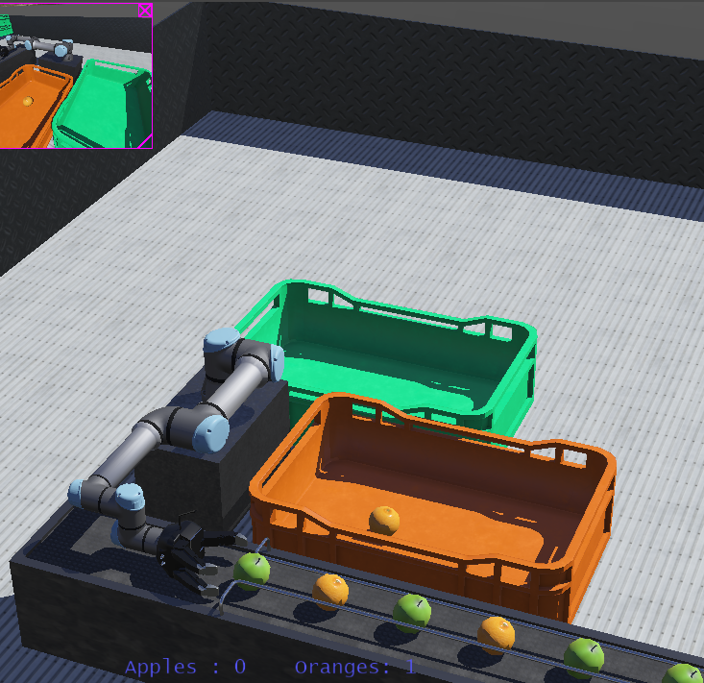
Test and Results
Expected Results
Accurate Sorting: The system is expected to correctly place all Apples into one bin and all Oranges into the other.
Real-time Counting: The controller maintains two counters (apple and orange) and displays the sorting result in the simulation window using the supervisor label function:
Apples : [Count] Oranges: [Count]

Slide 27
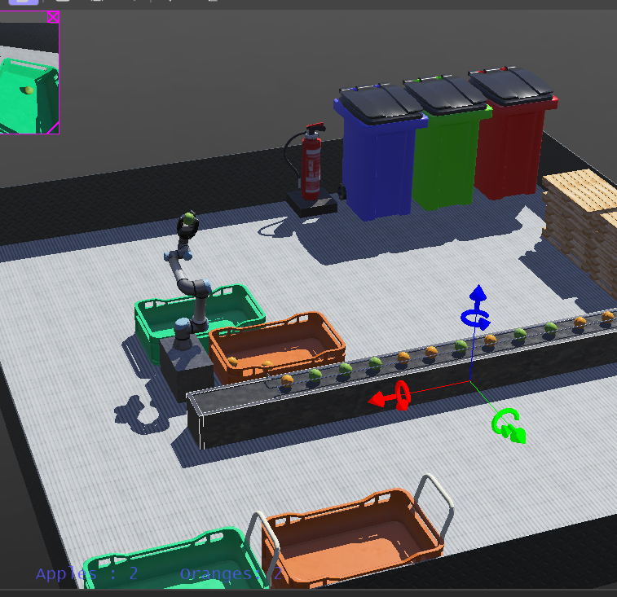
Conclusion
Key Achievements
Robust State Management: The design utilized a Finite State Machine (FSM) to provide a structured, sequential, and predictable control flow for the UR5e robot arm. This ensures reliable transitions between key operations: WAITING, PICKING, ROTATING, DROPPING, and ROTATE_BACK.
Sensor Integration: The system effectively combined two key sensor modalities:
  A Distance Sensor for reliable object presence detection, serving as the primary trigger to initiate the sorting sequence.
  Camera Recognition to accurately identify the object's model (Apple or Orange), which is crucial for determining the correct sorting bin destination.
Targeted Actuation: The difference in the motor indexing based on the fruit type successfully generated the distinct pick-and-place trajectories required to deposit fruits into their respective bins.
Supervisor Control: The use of the Supervisor controller allowed for continuous and automated fruit generation, creating a dynamic and perpetual testing environment for the sorter.

Slide 28
References
  https://cyberbotics.com/doc/reference/nodes-and-api-functions
  https://www.cyberbotics.com/doc/guide/using-c
  https://cyberbotics.com/doc/guide/controller-programming
  https://cyberbotics.com/doc/reference/supervisor
  https://cyberbotics.com/doc/guide/supervisor-programming
  https://www.cyberbotics.com/doc/guide/ure
  https://cyberbotics.com/doc/reference/camera
  https://www.cyberbotics.com/doc/reference/distancesensor

